Slide 1

Cloud Infrastructure Automation Using Terraform & CloudFormation
PROG8870 – Cloud Architectures and Infrastructure as Code
Presented by:
Archit Patel

Slide 2

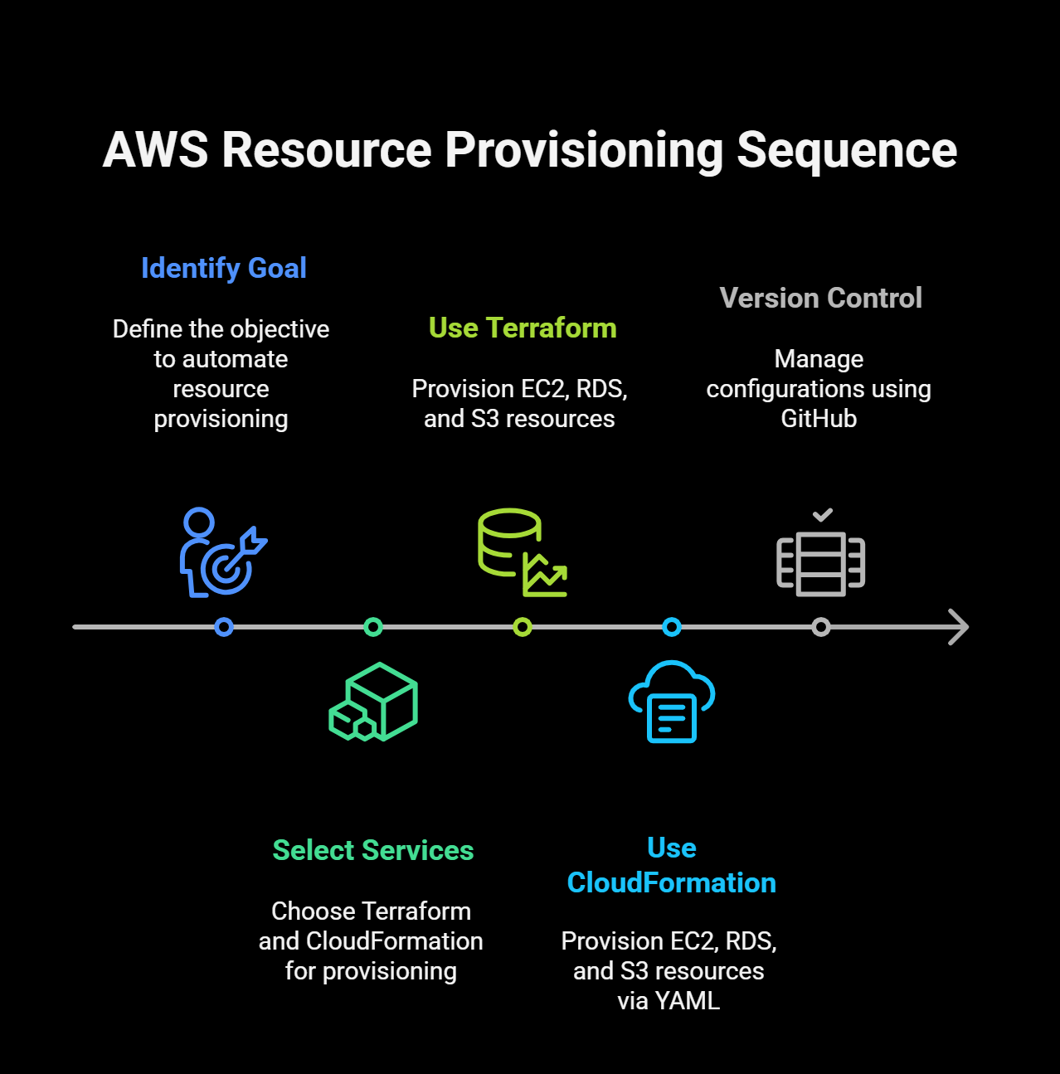
Project Overview
Goal: Automate AWS resource provisioning using Terraform and CloudFormation.
Services Used:
Terraform for EC2, RDS, and S3 provisioning
CloudFormation for EC2, RDS, and S3 via YAML templates
Version-controlled using GitHub

Slide 3
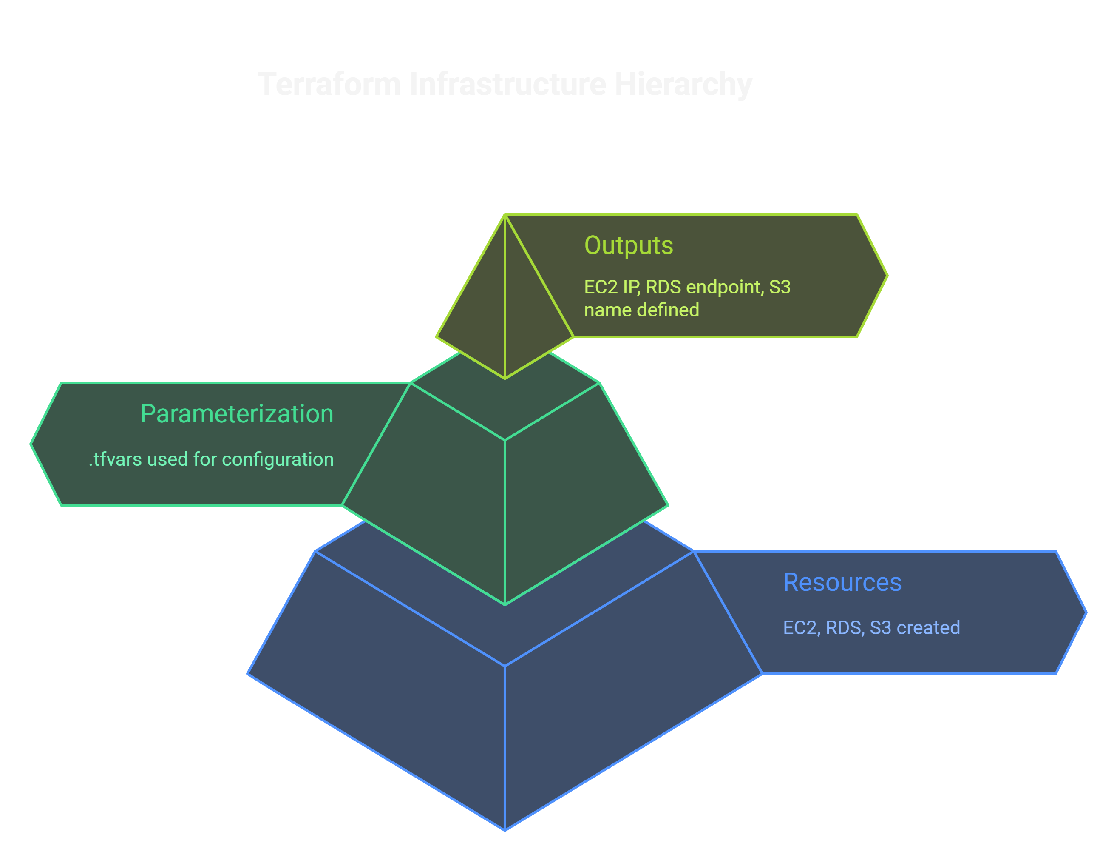
Terraform infrastructure
Created the following resources:
EC2 Instance
RDS Database (MySQL)
S3 Bucket
Used .tfvars for parameterization
Outputs defined for:
EC2 Public IP
RDS Endpoint
S3 Bucket Name

Slide 4

Terraform project structure
terraform/
├── main.tf
├── provider.tf
├── variables.tf
├── terraform.tfvars
├── backend.tf
├── outputs.tf
.gitignore used to exclude:
.terraform/, .tfstate, *.tfvars
State managed locally

Slide 5
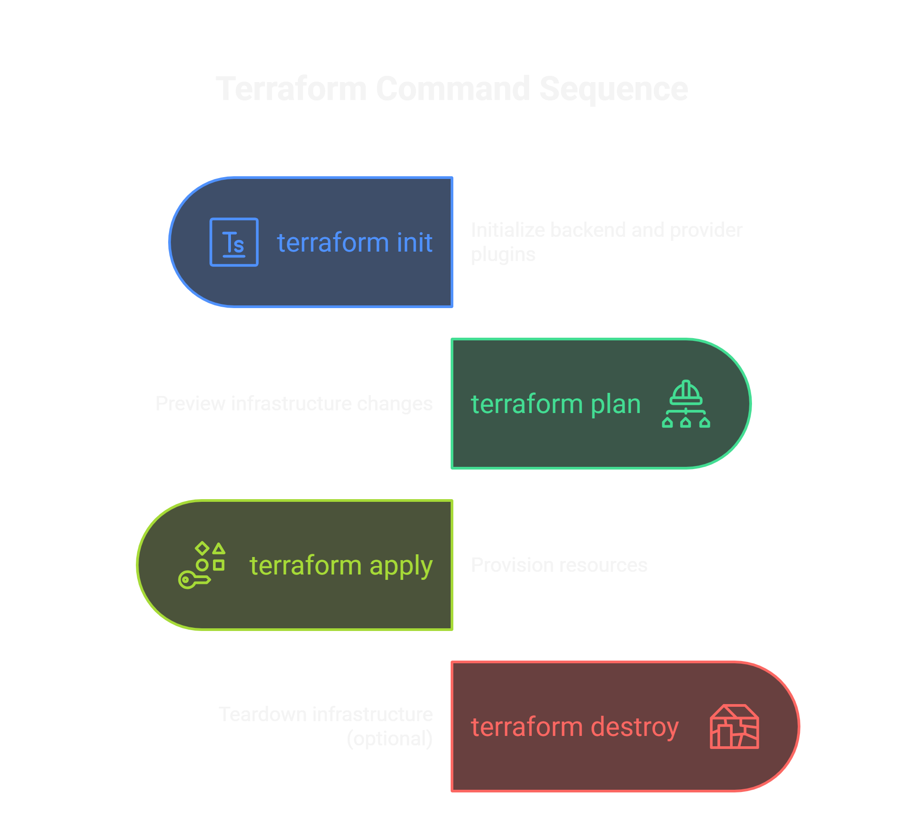
Terraform commands used

Slide 6
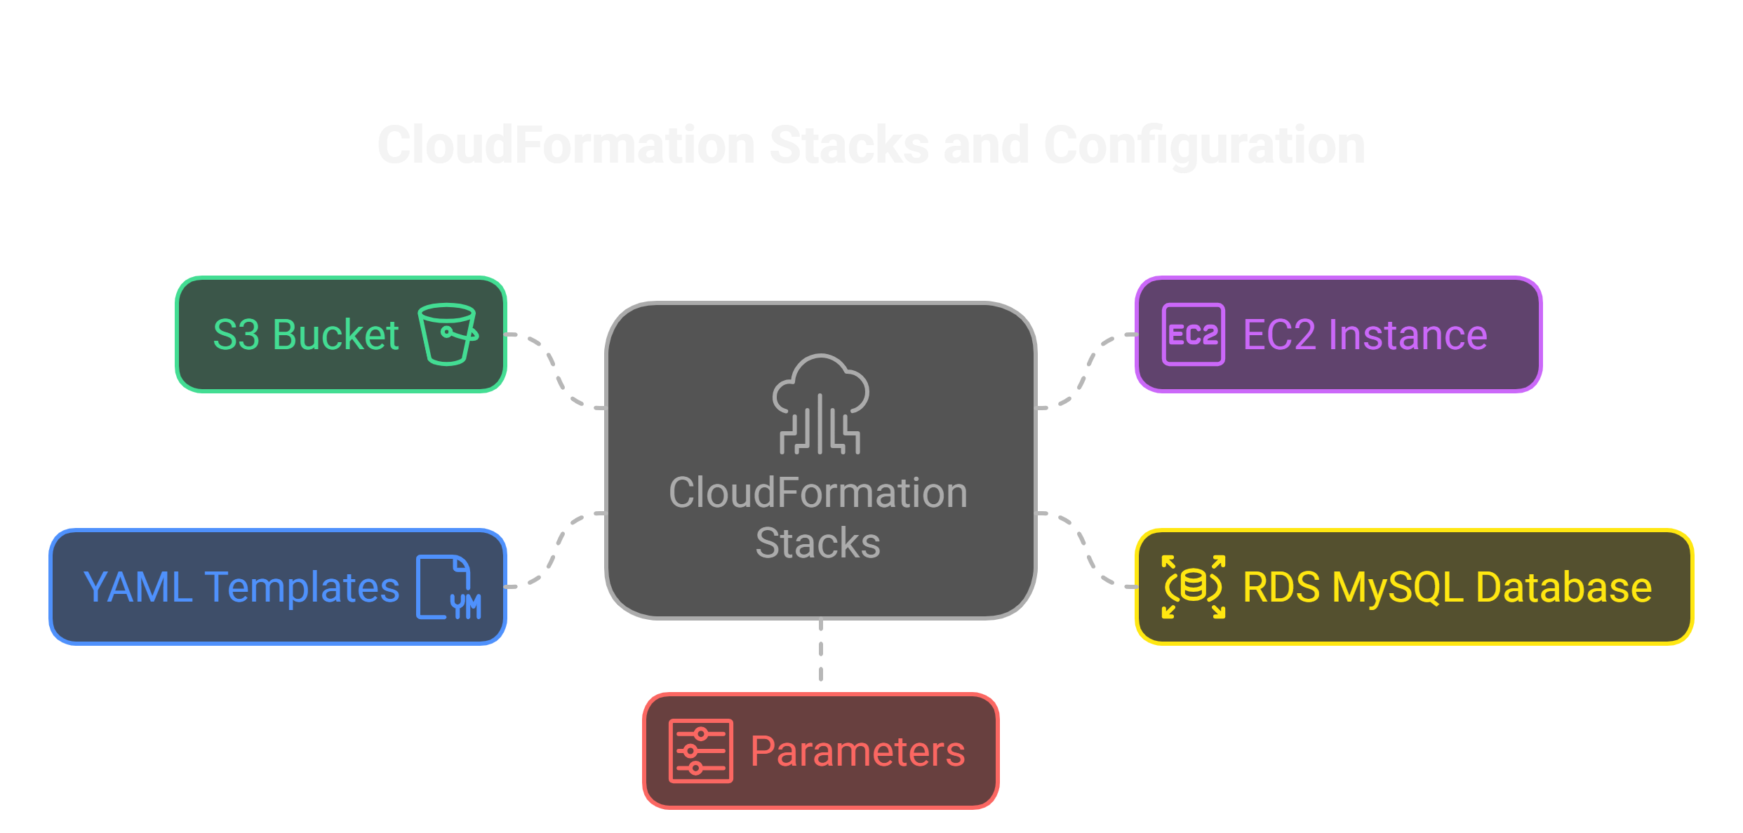
Cloudformation stack

Slide 7
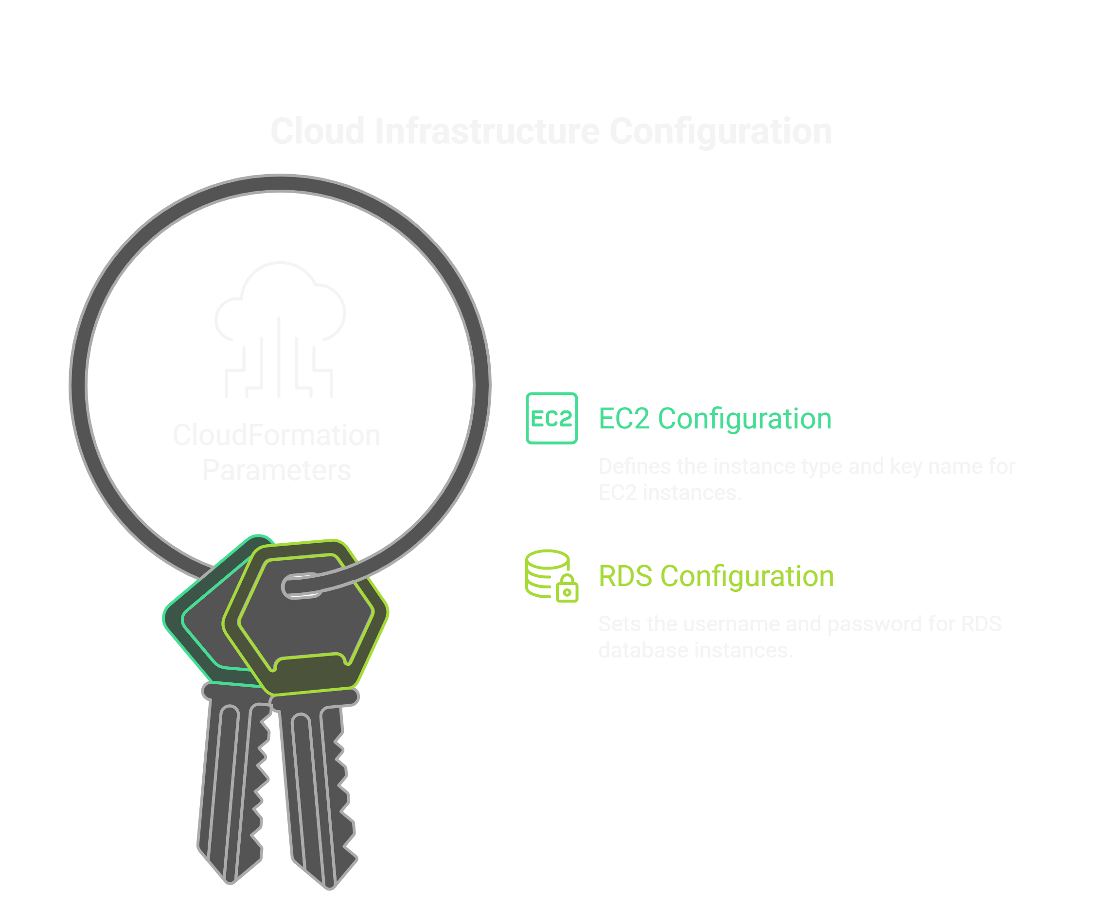
Cloudformation parameters
For EC2:
InstanceType: t2.micro
KeyName: final-project-key
For RDS:
DBUsername: admin
DBPassword: MySecurePassword123!

Slide 8
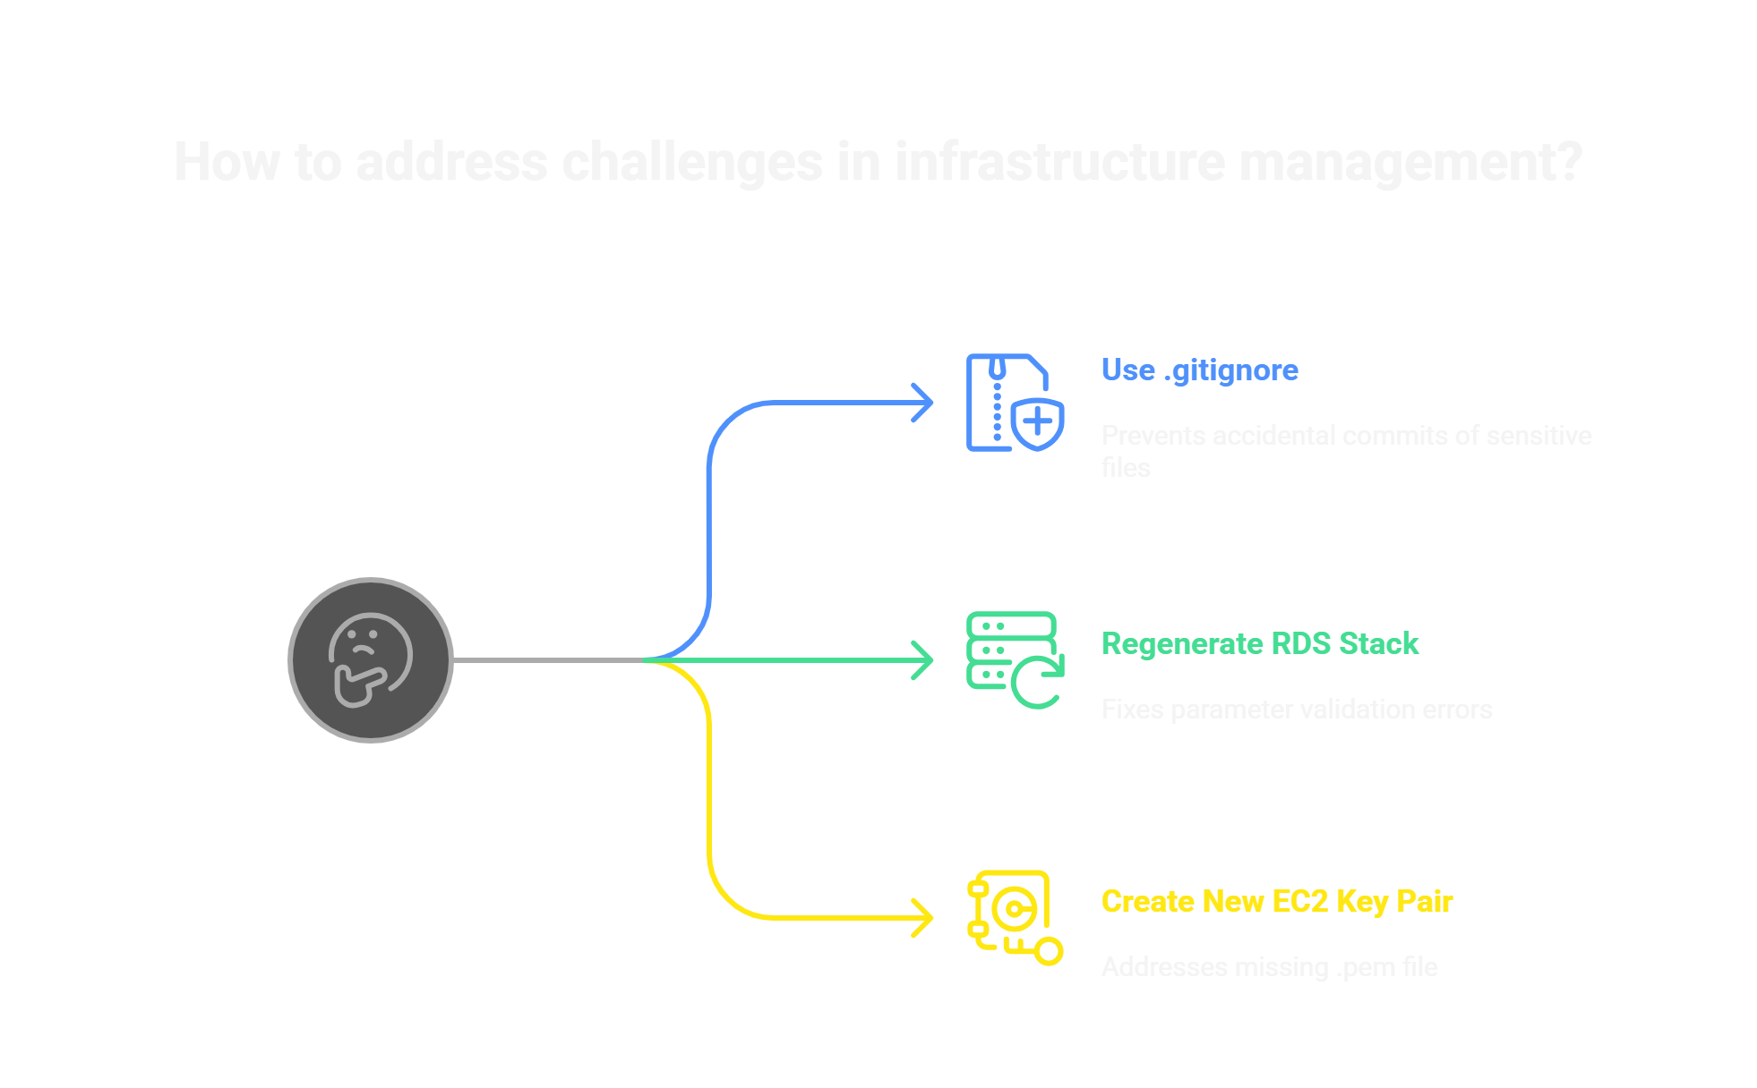
Challenges faced
Accidentally committed .terraform/ and .tfstate files
Fixed by using .gitignore and git filter-repo
Had to regenerate RDS stack due to parameter validation errors
Created new EC2 Key Pair when .pem file was missing

Slide 9
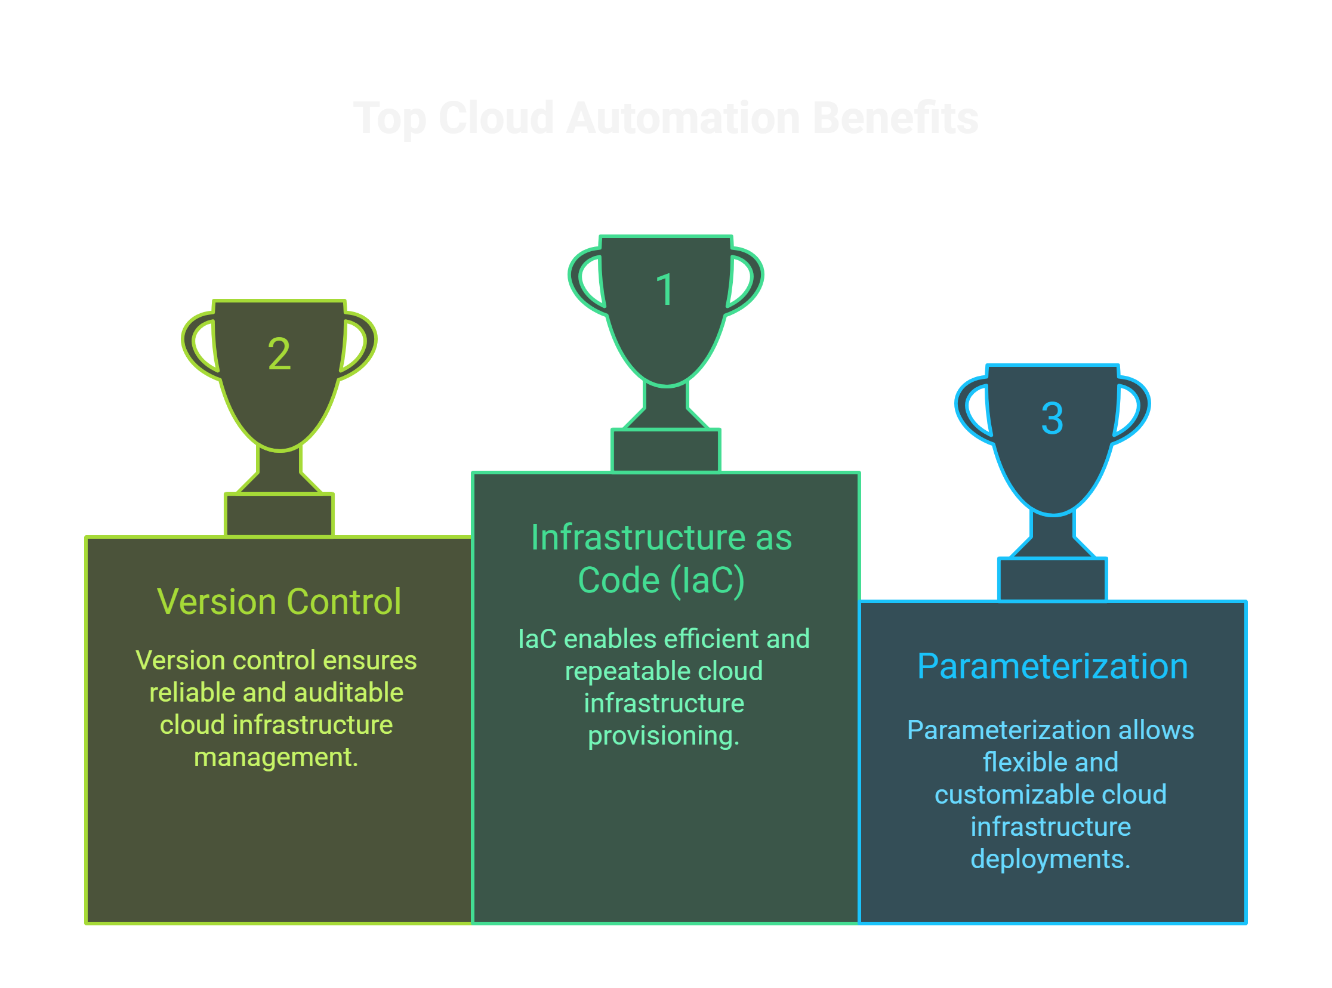
conclusion
Successfully provisioned a 3-tier AWS setup using both tools
Demonstrated:
Infrastructure as Code (IaC)
Version control
Parameterization
Real-world application of cloud automation

Slide 10
Thank you
Questions?
GitHub Repository:
https://github.com/archittechienutz/PROG8870-FinalProject

